Slide 1

Group no 7:
Aryan Dubey (8)
Mangesh Sokalwar (62)
Aaryan Swami (63)

Slide 2
Problem Statement
In this current prevailing covid conditions we have decided to come up with an e-learning website application for students to study from home.
GateMaster is a website application made using Angular for Frontend (HTML, CSS and JavaScript) and Django for backend and database targeting students aspiring for Masters Degree and for getting Jobs in the Public Sector through the means of gate examination.
Our websites aims at providing all the material at one place for different streams for free hence saving valuable time and money of the students which they can invest in preparation.

Slide 3
Objective
Our project GateMaster is a website to help the student appearing for Gate examination in the near future.
Our website will contain study material for students appearing for multiple branches. It will contain video lectures on different topics and notes on the same for better preparation of the students.
It will also contain previous year Question Papers, both with solutions and without solutions so that the students can practice thoroughly.
Our website also has a mentor facility which students can avail for a one on one guiding session if needed.

Slide 4
Literature survey
References: YouTube videos and Existing Gate preparation Websites.
YouTube:
https://www.youtube.com/c/GateSmashers
https://www.youtube.com/c/nesoacademy/playlists
Gate Preparation Websites:
https://nptel.ac.in/gate_paper.html
https://gate.appliedroots.com

Slide 5
block Diagram
Video Lectures
Streams
Question Papers
Notes
About GATE
Some information about the GATE examination
Register
Login
Home Page
Mentor
One on One Guiding Session
Log Out

Slide 6
Features and functionality
Email Verification: The email that the user registers with is verified through an OTP verification method.
Streams: The user can select the stream he is in and will be directed to a page with video lectures, notes, solved and unsolved question papers for preparation.
Mentor: If user faces difficulty in preparing for the exam or needs guidance he can interact with our mentor, who has already given the exam.
About Gate: Anyone who has just started preparing and has little to no knowledge regarding the examination, can educate himself in the About Gate section where users can get previous year cutoffs, important dates of this year examination, application fee and much more.

Slide 7
Future scope
Discussion Forum: As our user database increases we are planning to add a discussion forum common to all the users. In the discussion forum the users can share their views, questions or anything related to the exam in the form of comments.
Test Series: We are also planning to include test series of the examination for even better and thorough preparations of the students.
Paid Plans: We will also include paid plans in future that will include additional features for the students.

Slide 8
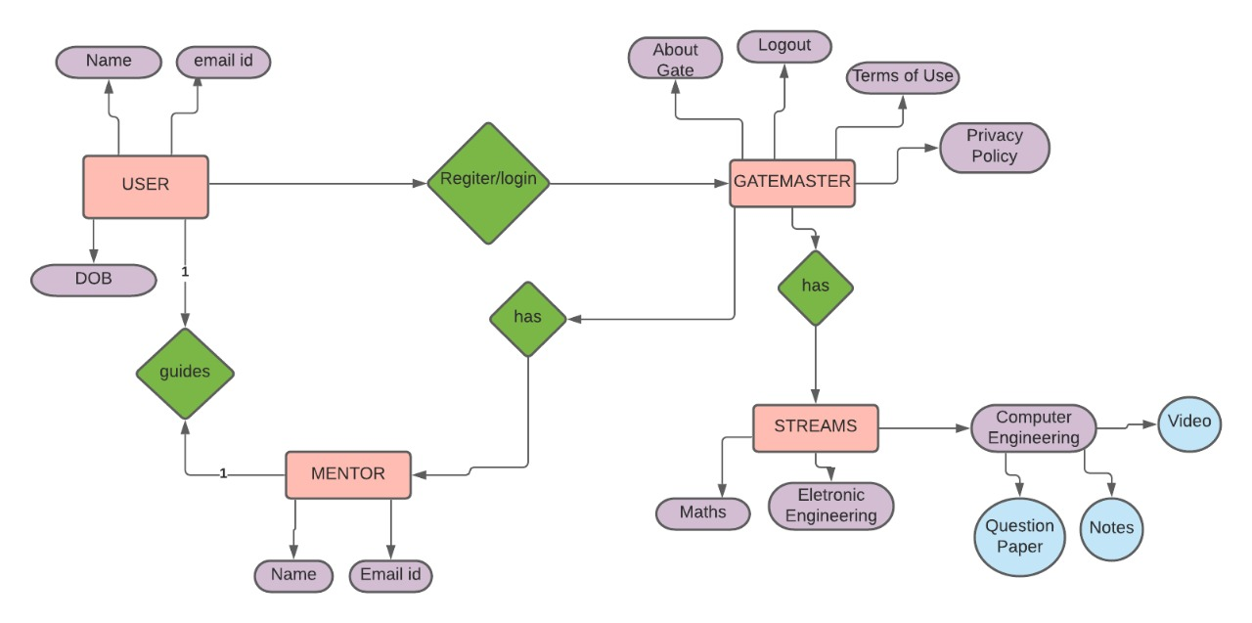
ER Diagram

Slide 9
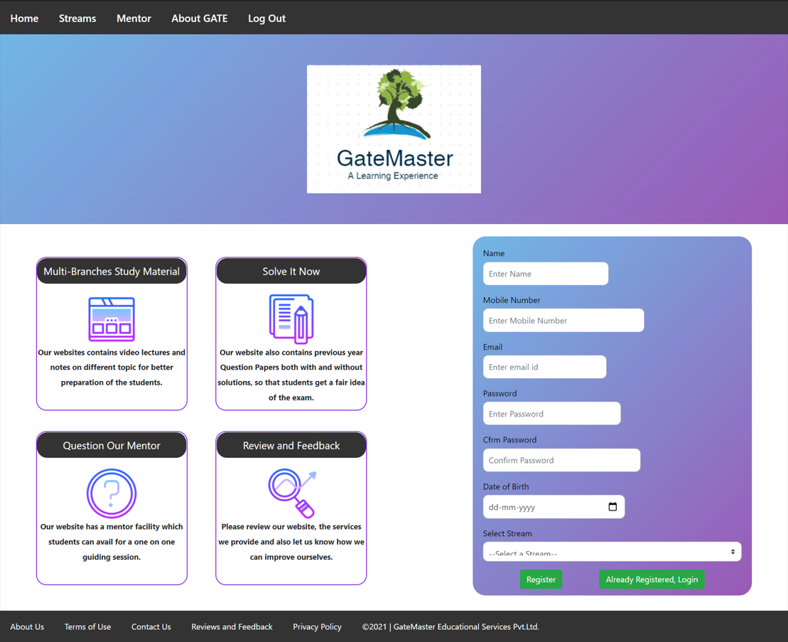
Frontend implementation
Home Page

Slide 10
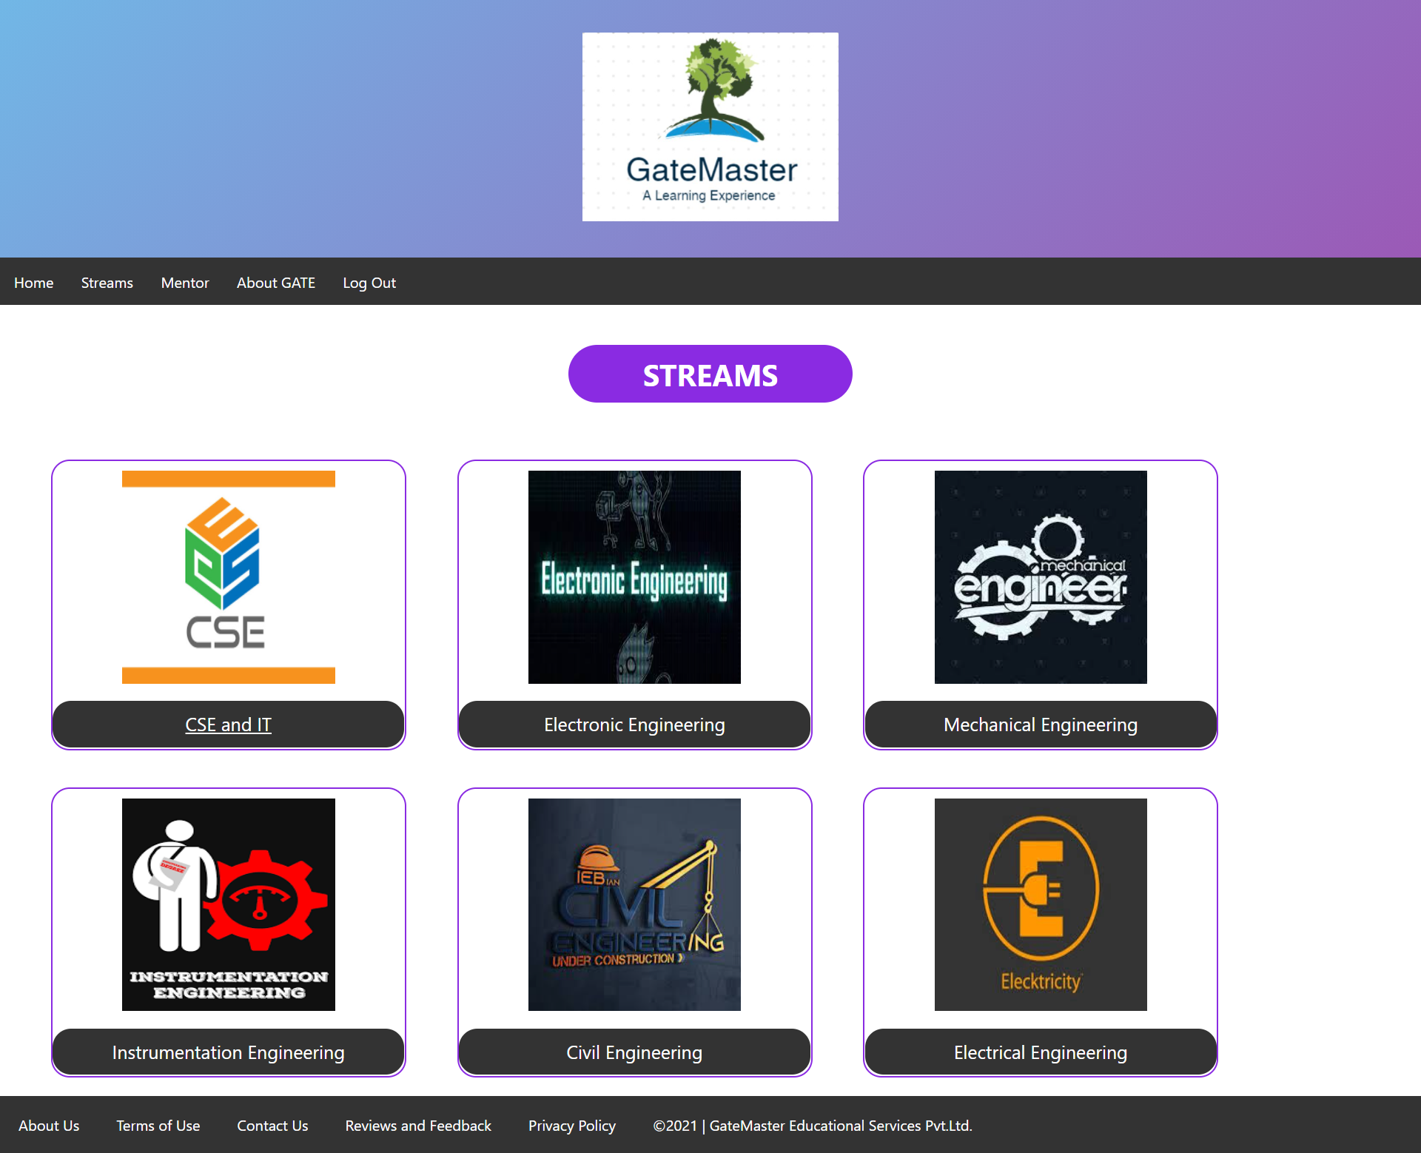
Streams

Slide 11
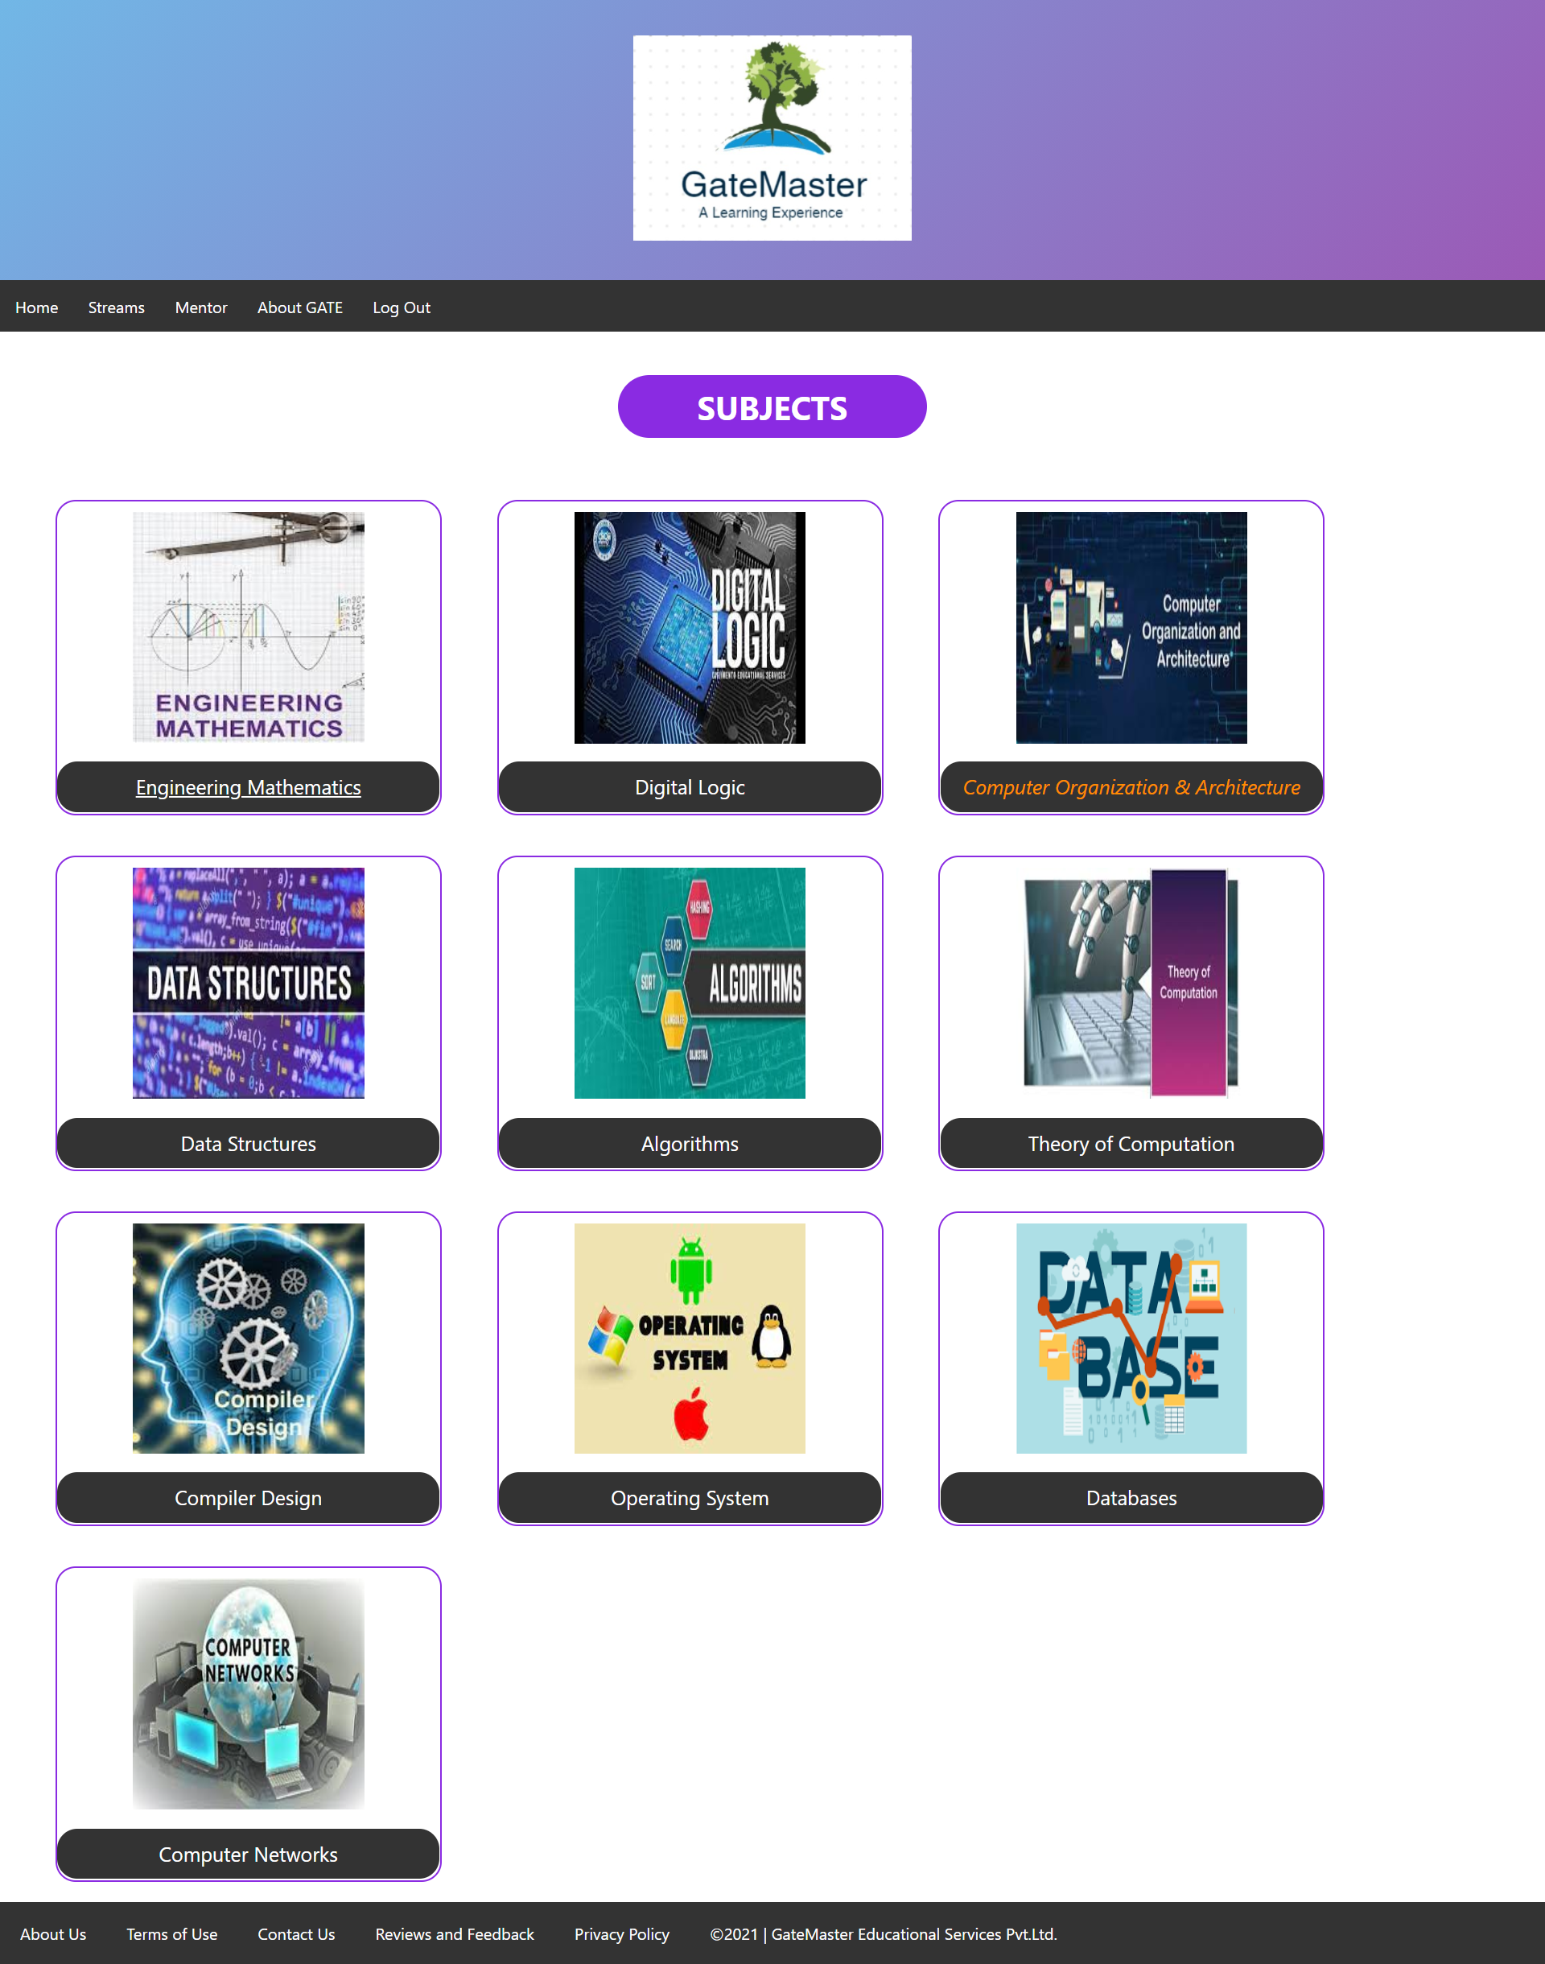
Subjects

Slide 12
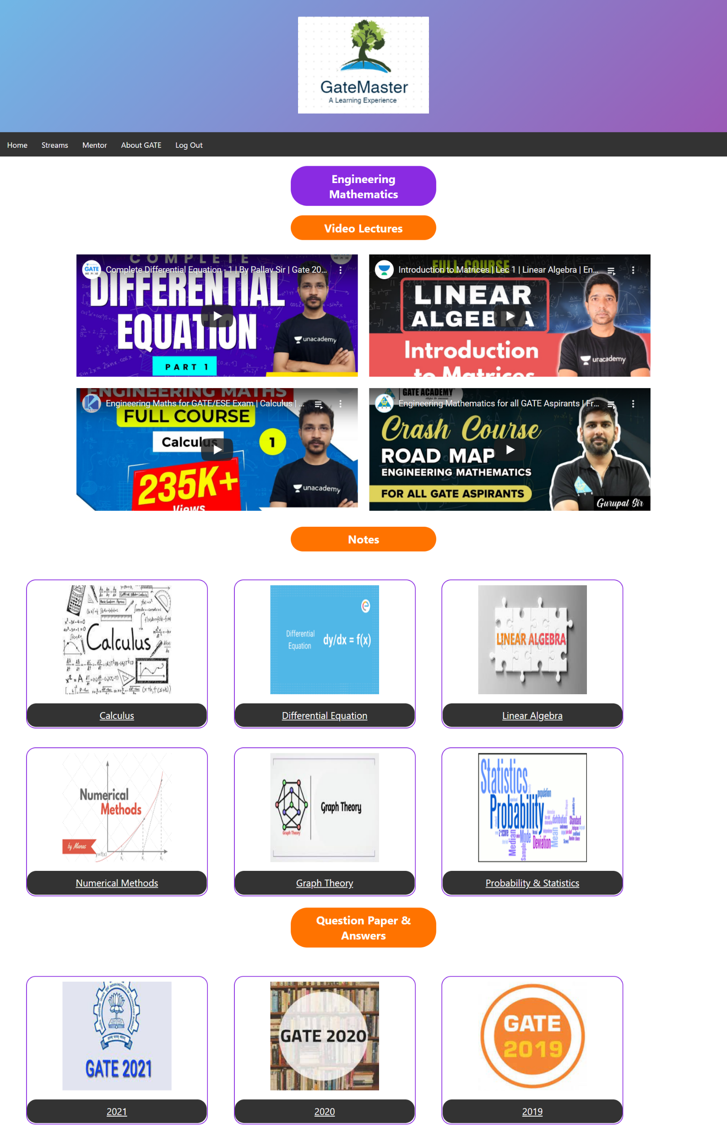
Study Material

Slide 13
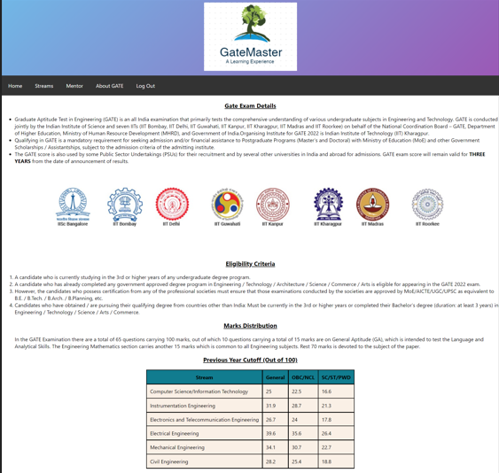
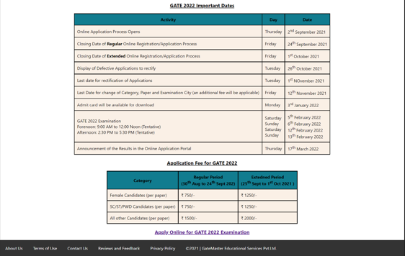
About Gate Page

Slide 14
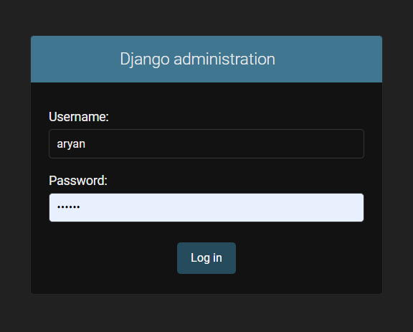
Django Database
Django Admin Login

Slide 15
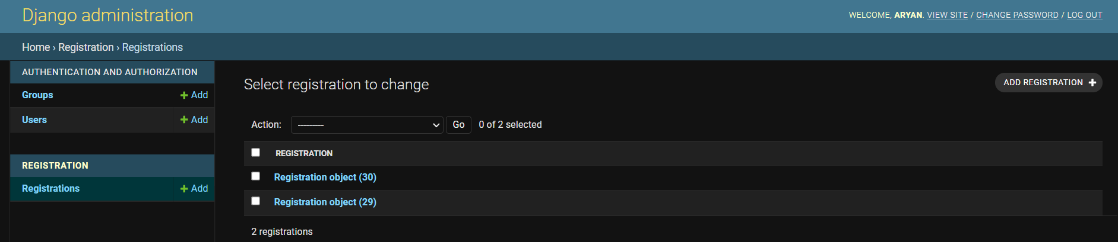
Registration Database

Slide 16
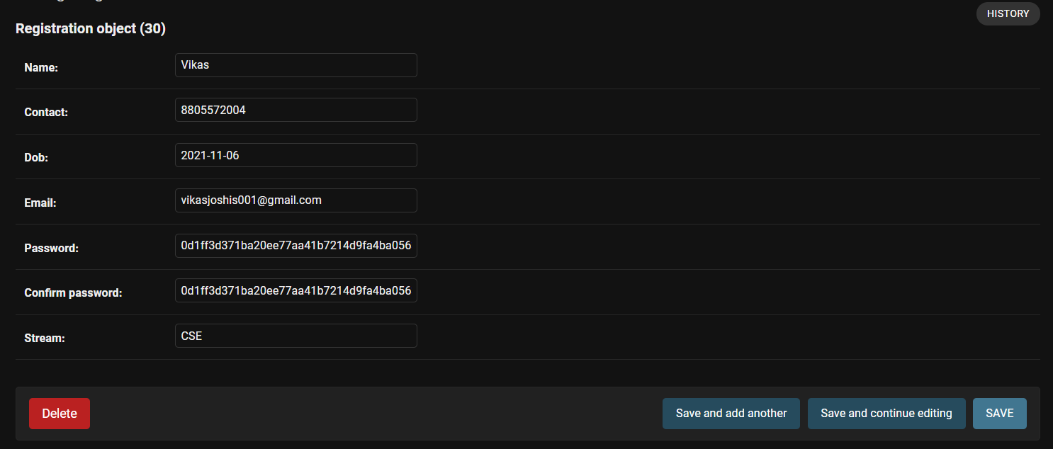
User Data

Slide 17
Thank you

